Slide 2
Topics
Introduction to Functions
Void functions and value returning functions
Local Variables
Global Variables and Global Constants
pass keyword
Keyword vs. positional arguments
Default arguments
Returning None From a Function
The math Module and random Module
Storing Functions in Modules
Conditionally executing the main function

Slide 3
Introduction to Functions
Function: group of statements within a program that perform a specific task
  Usually, one task of a large program
    Functions can be executed in order to perform overall program task
  Known as divide and conquer approach
Modularized program: program wherein each task within the program is in its own function

Slide 4
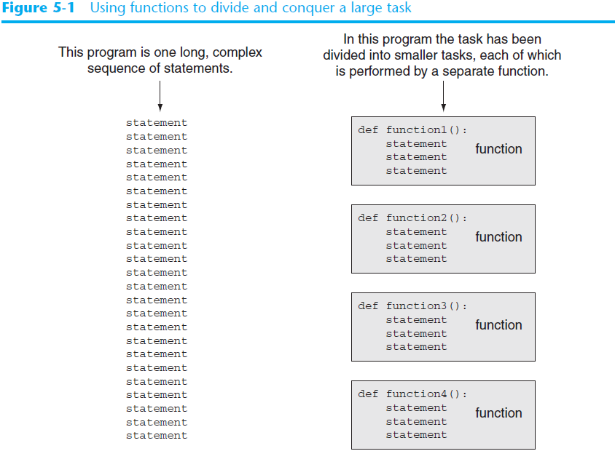

Slide 5
Benefits of Modularizing a Program with Functions
The benefits of using functions include:
  Simpler code
  Code reuse
    write the code once and call it multiple times
  Better testing and debugging
    Can test and debug each function individually
  Faster development
  Easier facilitation of teamwork
    Different team members can write different functions

Slide 6
Void Functions and Value-Returning Functions
A void function:
  Simply executes the statements it contains and then terminates.
A value-returning function:
  Executes the statements it contains, and then it returns a value back to the statement that called it.

Slide 7
Function Names
Functions are given names
  Function naming rules:
    Cannot use keywords as a function name
    Cannot contain spaces
    First character must be a letter or underscore
    All other characters must be a letter, number or underscore
    Uppercase and lowercase characters are distinct
  Function name should be descriptive of the task carried out by the function

Slide 8
Defining and Calling a Function (cont’d.)
You create a function by defining it and use the function by calling it.
Function definition: specifies what the function does, consists of the header and the body
  def function_name():
    statement
    statement

Slide 9
Defining and Calling a Function (cont’d.)
Call a function to execute it
  When a function is called:
    Interpreter jumps to the function and executes statements in the block
    Interpreter jumps back to part of program that called the function
      Known as function return

Slide 10
Indentation in Python
In Python, each line in a block must be indented
  Lines in block must begin with the same number of spaces
  Use tabs or spaces to indent lines in a block, but not both as this can confuse the Python interpreter
  IDLE automatically indents the lines in a block
  Blank lines that appear in a block are ignored

Slide 11
The main Function
It is common for a program to have a main function that is called when the program starts.
The main function contains a program’s mainline logic, which is the overall logic of the program.
The main function then calls other functions in the program as they are needed.

Slide 12
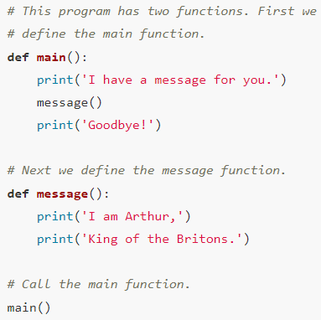
Example of a Function

Slide 13
Designing a Program to Use Functions
In a flowchart, which is a tool to design a program, a function is shown with a rectangle that has vertical bars at each side and the function name written in it.
Programmers typically draw a separate flowchart for each function in a program.
When drawing a flowchart for a function, the starting terminal symbol usually shows the name of the function, and the ending terminal symbol usually reads Return.

Slide 14
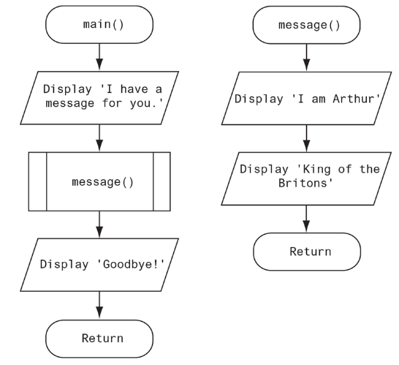
Designing a Program to Use Functions

Slide 15
Designing a Program to Use Functions
Programmers commonly use a technique known as top-down design to break down an algorithm into functions.
This process is called top-down design because the programmer begins by looking at the topmost level of tasks that must be performed and then breaks down those tasks into lower levels of subtasks.
Flowcharts are good tools for graphically depicting the flow of logic inside a function, but they do not give a visual representation of the relationships between functions.
Programmers commonly use hierarchy charts (also known as structure charts) for this purpose.
A hierarchy chart shows boxes that represent each function in a program.
The boxes are connected in a way that illustrates the functions called by each function

Slide 16
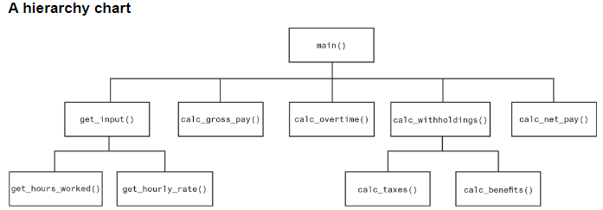
Designing a Program to Use Functions

Slide 17
Using the pass Keyword
Sometimes when you are initially writing a program’s code, you know the names of the functions you plan to use, but you might not know all the details of the code that will be in those functions.
When this is the case, you can use the pass keyword to create empty functions.
The pass keyword is ignored by the Python interpreter.
Later, when the details of the code are known, you can come back to the empty functions and replace the pass keyword with meaningful code
def fun1():
pass
def fun2():
pass

Slide 18
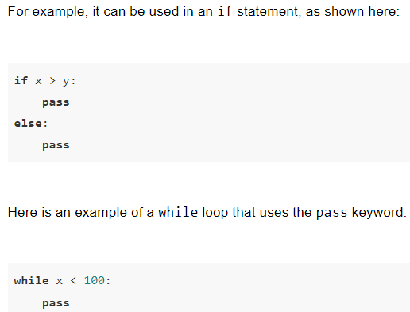
Using the pass Keyword
The pass keyword can, in fact, be used as a placeholder anywhere in your Python code.

Slide 19
Local Variables
Local variable: variable that is assigned a value inside a function
  Belongs to the function in which it was created
    Only statements inside that function can access it, error will occur if another function tries to access the variable
  Different functions may have local variables with the same name

Slide 20
Passing Arguments to Functions
Argument: piece of data that is sent into a function
  Function can use argument in calculations
  When calling the function, the argument is placed in parentheses following the function name
Parameter variable: variable that is assigned the value of an argument when the function is called
  The parameter and the argument reference the same value

Slide 21
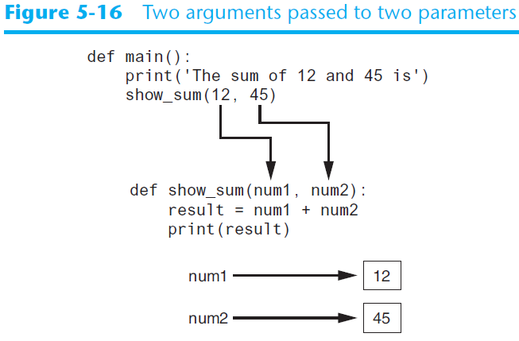
Passing Arguments to Functions (cont’d.)

Slide 22
Pass by Value Or Pass by Reference
Depending on the type of object you pass in the function, the function behaves differently.
Immutable objects show “pass by value” whereas mutable objects show “pass by reference”.

Slide 23
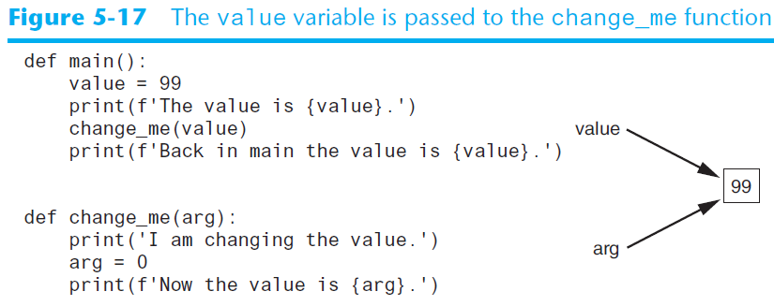
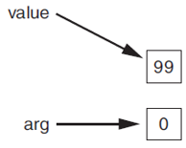
Pass by Value Or Pass by Reference
Numbers and Strings are immutable.

Slide 24
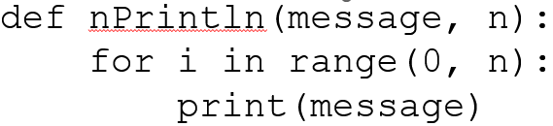
Passing Arguments by Positions
When you pass arguments by position, the arguments need to be in the same order as their respective parameters in the function header.
Example
  nPrintln(“Welcome to Python”, 5)
The following is incorrect
  nPrintln(4, “Computer Science”)

Slide 25
Keyword Arguments
You can also call a function using keyword arguments where you pass each argument in the form of name=value
The following is correct using positional arguments:
nPrintln(n = 4, message = “Computer Science”)
Note: It is possible to mix positional arguments with keyword arguments, but the positional arguments cannot appear after any keyword arguments.

Slide 26

Keyword-Only Parameters
In a function definition, you can require that all arguments be passed as keyword arguments
Python provides special notation for this purpose: simply write an asterisk, followed by a comma, at the beginning of the function's parameter list.
You can call the above function as:
  nPrintln(message = 'Hello', n = 5)
The following will give an error:
  nPrintln('Hello', 5) # Error

Slide 27
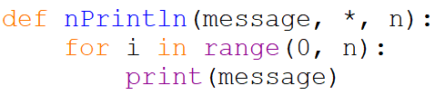
Keyword-Only Parameters
The * can appear at any position in the parameter list, but only the parameters that appear after it will become keyword-only parameters
In this example, only n is a keyword-only parameters.

Slide 28
Positional-Only Parameters
A positional-only parameter will accept only positional arguments
To declare positional-only parameters, insert a forward-slash into the parameter list
All the parameters that appear before the forward-slash will be positional-only parameters

Slide 29
Positional-Only Parameters
Example:
The two parameters are positional-only and will not accept keyword arguments
This function call will work:
  nPrintln('Hello', 5)
But this one will not:
  nPrintln(message = 'Hello', n = 5) # Error
def nPrintln(message, n, /):
for i in range(0, n):
print(message)

Slide 30
Positional-Only Parameters
The / can appear at any position in the parameter list, but only the parameters that appear before it will become positional-only parameters
In this example, only message is a positional-only parameters
The parameter n can accept keyword arguments or positional arguments
def nPrintln(message, /, n):
for i in range(0, n):
print(message)

Slide 31
Default Arguments
In a function definition, you can provide a default argument for a parameter
In this example, the default argument 0.07 is provided for the tax_rate parameter
When we call the function, we must pass an argument for the price parameter, but we have the option of omitting the argument for the tax_rate parameter
The following statements will call the function:
  show_tax(100)
  show_tax(100, 0.08)
Default argument
def show_tax(price, tax_rate=0.07):
tax = price * tax_rate
print(f'The tax is {tax}.')

Slide 32
Default Arguments
In a function's parameter list, the parameters without default arguments must appear first, followed by the parameters with default arguments.
This is an invalid function:
def show_tax(price=10, tax_rate):
tax = price * tax_rate
print(f'The tax is {tax}.')

Slide 33
Global Variables
Global variable: created by assignment statement written outside all the functions
  Can be accessed by any statement in the program file, including from within a function
# Create a global variable.
number = 10
def main():
print(f'The number you entered is {number}.')
# Call the main function.
main()

Slide 34
Global Variables
If a function needs to assign a value to the global variable, the global variable must be redeclared within the function using the global keyword
# Create a global variable.
number = 0
def main():
global number
number = int(input('Enter a number: '))
show_number()
def show_number():
print(f'The number you entered is {number}.')
# Call the main function.
main()
The assignment statement in line 2 creates a global variable named number. Notice inside the main function, the global keyword is used to declare the number variable. This statement tells the interpreter that the main function intends to assign a value to the global number variable.

Slide 35
Global Variables
Most programmers agree that you should restrict the use of global variables, or not use them at all. The reasons are as follows:
  Global variables make debugging difficult. Any statement in a program file can change the value of a global variable. If you find that the wrong value is being stored in a global variable, you have to track down every statement that accesses it to determine where the bad value is coming from. In a program with thousands of lines of code, this can be difficult.
  Functions that use global variables are usually dependent on those variables. If you want to use such a function in a different program, most likely you will have to redesign it, so it does not rely on the global variable.
  Global variables make a program hard to understand. A global variable can be modified by any statement in the program. If you are to understand any part of the program that uses a global variable, you have to be aware of all the other parts of the program that access the global variable.
In most cases, you should create variables locally and pass them as arguments to the functions that need to access them.

Slide 36
Global Constants
Although you should try to avoid the use of global variables, it is permissible to use global constants in a program.
A global constant is a global name that references a value that cannot be changed.
Because a global constant’s value cannot be changed during the program’s execution, you do not have to worry about many of the potential hazards that are associated with the use of global variables.
Although the Python language does not allow you to create true global constants, you can simulate them with global variables and not re-declaring them within functions.

Slide 37
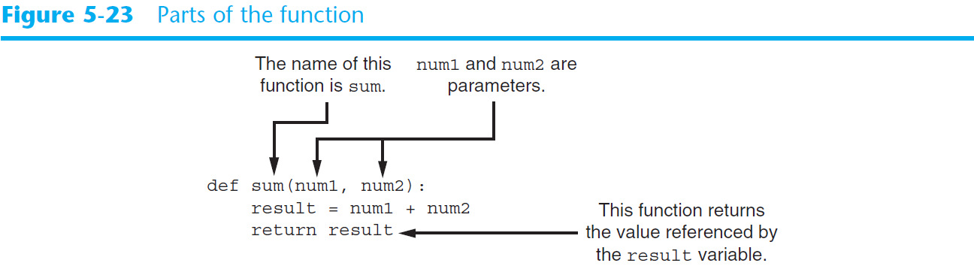
Value-Returning Functions
A value-returning function is a function that returns a value back to the part of the program that called it.
To write a value-returning function, you write a simple function and add one or more return statements
Use the returned value: Assign it to a variable or use as an argument in another function

Slide 38
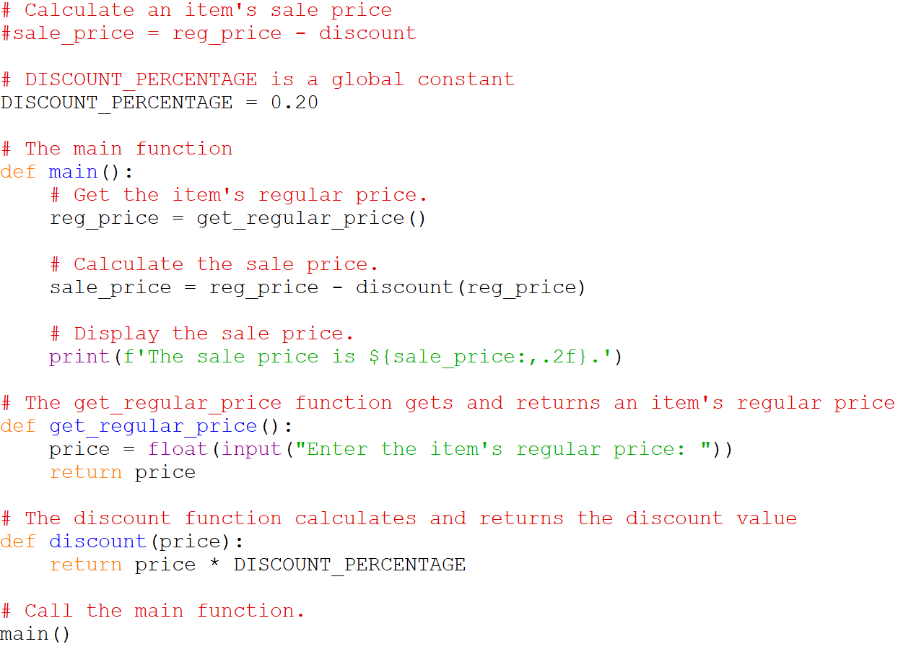
Value-Returning Functions

Slide 39
Value-Returning Functions
A function can also return an f-string.
The purpose of the following function is to accept a numeric value as an argument and return a string that contains that value formatted as a dollar amount.
For example, if we pass the floating-point value 89.578 to the function, the function will return the string '$89.58’.
  def dollar_format(value):
  return f'${value:,.2f}'

Slide 40
Returning Multiple Values
In Python, a function can return multiple values
  Specified after the return statement separated by commas
  Format: return expr1, expr2, etc.
  When you call such a function in an assignment statement, you need a separate variable on the left side of the = operator to receive each returned value

Slide 41
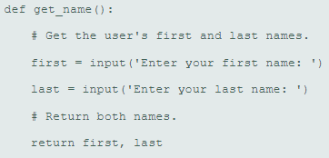
Returning Multiple Values
Example:
Calling the above function:
first_name, last_name = get_name()

Slide 42
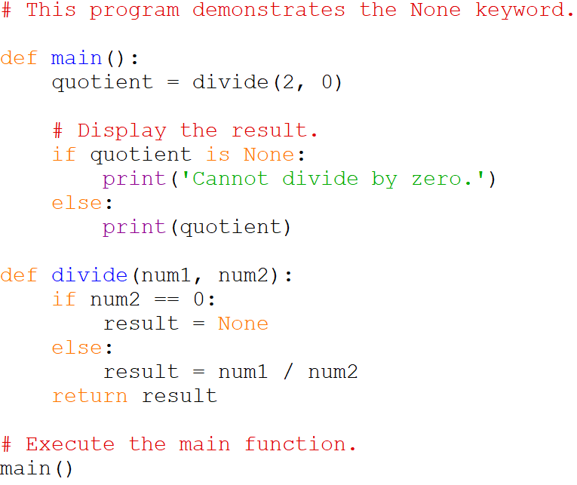
Returning None From a Function
The special value None means "no value"
Sometimes it is useful to return None from a function to indicate that an error has occurred

Slide 43
Standard Library Functions and Modules
Python, as well as most programming languages, comes with a standard library of functions that have already been written for you.
Some of Python’s library functions including print, input, and range that you have used before are built into the Python interpreter. If you want to use one of these built-in functions in a program, you simply call the function.
Many of the functions in the standard library, however, are stored in files that are known as modules.
These modules, which are copied to your computer when you install Python, help organize the standard library functions.
For example, functions for performing math operations are stored together in a module, functions for working with files are stored together in another module, and so on.
In order to call a function that is stored in a module, you have to write an import statement at the top of your program that tells the interpreter the name of the module that contains the function.
For example: import math
This statement causes the interpreter to load the contents of the math module into memory and makes all the functions in the math module available to the program.

Slide 44
random Module
Random number are useful in a lot of programming tasks
random module: includes library functions for working with random numbers
Dot notation: notation for calling a function belonging to a module
  Format: module_name.function_name()
  Example: random.randint()

Slide 45
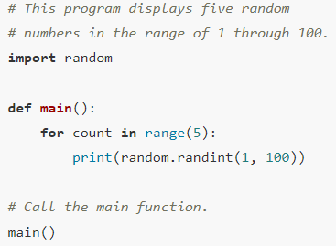
Generating Random Numbers
randint function: generates a random number in the range (inclusive) provided by the arguments

Slide 46
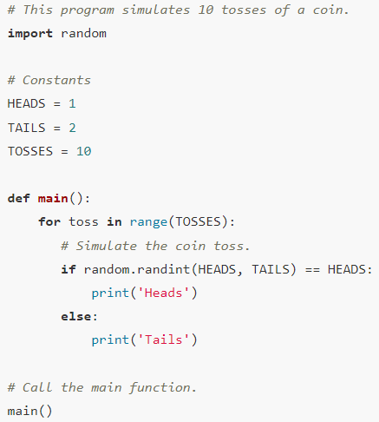
Generating Random Numbers

Slide 47
Generating Random Numbers
randrange function: similar to range function, but returns randomly selected integer from the resulting sequence
Note that, while for randint function, the range is inclusive, for randrange function, the range is exclusive.
  random.randint(1, 2) will generate 1 or 2
  random.randrange(1, 2) will only generate 1
random.randrange(0, 101, 10) will return a randomly selected value from:
[0, 10, 20, 30, 40, 50, 60, 70, 80, 90, 100]

Slide 48
Generating Random Numbers
random function: returns a random float in the range of 0.0 and 1.0 (but not including 1.0)
  Does not receive arguments
  Example: random.random()
uniform function: returns a random float but allows user to specify range (inclusive)
  Example: random.uniform(1.0, 10.0)

Slide 49
Random Number Seeds
The numbers that are generated by the functions in the random module are not truly random but pseudorandom as that are calculated by a formula.
The formula that generates random numbers has to be initialized with a value known as a seed value.
When the random module is imported, it retrieves the system time from the computer’s internal clock and uses that as the seed value.
The system time is an integer that represents the current date and time, down to a hundredth of a second.

Slide 50
Random Number Seeds
If the same seed value were always used, the random number functions would always generate the same series of pseudorandom numbers.
Because the system time changes every hundredth of a second, it is a fairly safe bet that each time you import the random module, a different sequence of random numbers will be generated.
However, there may be some applications in which you want to always generate the same sequence of random numbers.
If that is the case, you can call the random.seed function to specify a seed value.

Slide 51
Random Number Seeds
The following program generates the same set of random numbers every time you run it.
However, if you remove the random.seed(10) statement, it will generate a different set of random numbers every time.
# This program demonstrates use of seed value.
import random
def main():
random.seed(10)
for i in range (0, 5):
print(random.randint(1,100))
# Execute the main function.
main()

Slide 52
The math Module
math module: part of standard library that contains functions that are useful for performing mathematical calculations
  Typically accept one or more values as arguments, perform mathematical operation, and return the result
  Use of module requires an import math statement
  Example: print(math.sqrt(5))
  To round off: print(f'{math.sqrt(5):.2f}')

Slide 53
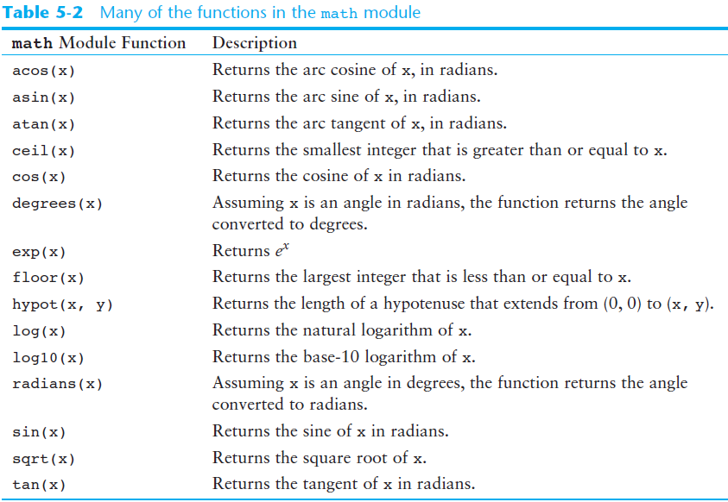
The math Module (cont’d.)

Slide 54
The math Module (cont’d.)
The math module defines variables pi and e, which are assigned the mathematical values for pi and e
  Can be used in equations that require these values, to get more accurate results
Variables must also be called using the dot notation
  Example:
  circle_area = math.pi * radius**2

Slide 55
Storing Functions in Modules
In the previous slides, we looked at two built-in modules, random and math, that store all related functions together in a single file.
You can also create your own modules and store all related functions together in a single file.
These modules can then be imported, and the functions called when needed.

Slide 56
Storing Functions in Modules
Modularization: grouping related functions in modules
  Makes program easier to understand, test, and maintain
  Make it easier to reuse code for multiple different programs
    Import the module containing the required function to each program that needs it
In the next example, we create two modules, one has all the functions related to circles and the other one has all the functions related to rectangles

Slide 57
Storing Functions in Modules
# File name: circle.py
import math
# Returns the area of the circle.
def area(radius):
return math.pi * radius**2
# Returns the circle's circumference.
def circumference(radius):
return 2 * math.pi * radius
# File name: rectangle.py
# Returns the rectangle's area.
def area(width, length):
return width * length
# Returns the rectangle's perimeter.
def perimeter(width, length):
return 2 * (width + length)
# File name: test.py, uses the above two modules
import circle
import rectangle
def main():
print("Area of a circle with radius 5: ", circle.area(5))
print("Area of a rectangle with l=5, b=5: ", rectangle.area(5, 5))
# Execute the main function.
main()

Slide 58
Conditionally Executing the main Function in a Module
It is possible to create a module that can be run as a standalone program or imported into another program
Python provides a way to make this determination.
When the Python interpreter is processing a source code file, it creates a special variable named _ _name_ _.
If the file is being executed as a standalone program, the _ _name_ _ variable will be set to the string '_ _main_ _’.
If the file is being imported as a module, the _ _name_ _ variable will be set to the name of the module.
You can use the value of the _ _name_ _variable to determine whether the main function should execute or not.
  If the _ _name_ _variable is equal to '_ _main_ _', you should execute the main function because the file is being executed as a standalone program. Otherwise, you should not execute the main function because the file is being imported as a module.

Slide 59
Conditionally Executing the main Function in a Module
# File name: rectangle.py
# Returns the rectangle's area.
def area(width, length):
return width * length
# Returns the rectangle's perimeter.
def perimeter(width, length):
return 2 * (width + length)
# The main function
def main():
print('The area is', area(3, 7))
main()
You can run this file as a standalone file, for e.g., by pressing F5.
The program displays: The area is 21

Slide 60
Conditionally Executing the main Function in a Module
# File name: test.py
import rectangle
def main():
print("Area of a rectangle with l=5, b=5: ", rectangle.area(5, 5))
main()
I am using the rectangle file as a module to use call area function
I don’t want the main function in rectangle to be called
However, it gets called.
How do I prevent that?
Output
The area is 21
Area of a rectangle with l=5, b=5: 25

Slide 61
Conditionally Executing the main Function in a Module
# File name: rectangle.py
# Returns the rectangle's area.
def area(width, length):
return width * length
# Returns the rectangle's perimeter.
def perimeter(width, length):
return 2 * (width + length)
# The main function
def main():
print('The area is', area(3, 7))
# Call main function ONLY if the file is being run as a standalone program.
if __name__ == '__main__':
main()
If you run this file as a standalone file, for e.g., by pressing F5, the if condition is true, and the main method is called which displays: The area is 21

Slide 62
Conditionally Executing the main Function in a Module
# File name: test.py
import rectangle
def main():
print("Area of a rectangle with l=5, b=5: ", rectangle.area(5, 5))
# Execute the main function.
if __name__ == '__main__':
main()
Here, when you run the test file, the rectangle file is being imported as module.
So, the if condition in the rectangle file will be false as the name variable is not equal to __main__. So, the main method of the rectangle file is not called.

Slide 63
Summary
This chapter covered:
  The advantages of using functions
  The syntax for defining and calling a function
  Global variables, global constants, and their advantages and disadvantages
  Using library functions and the import statement
  Modules, including:
    The random and math modules
    Grouping your own functions in modules

